Slide 1
Working With Namespaces
Notes:
Working with fictional company Jackson electric

Slide 2
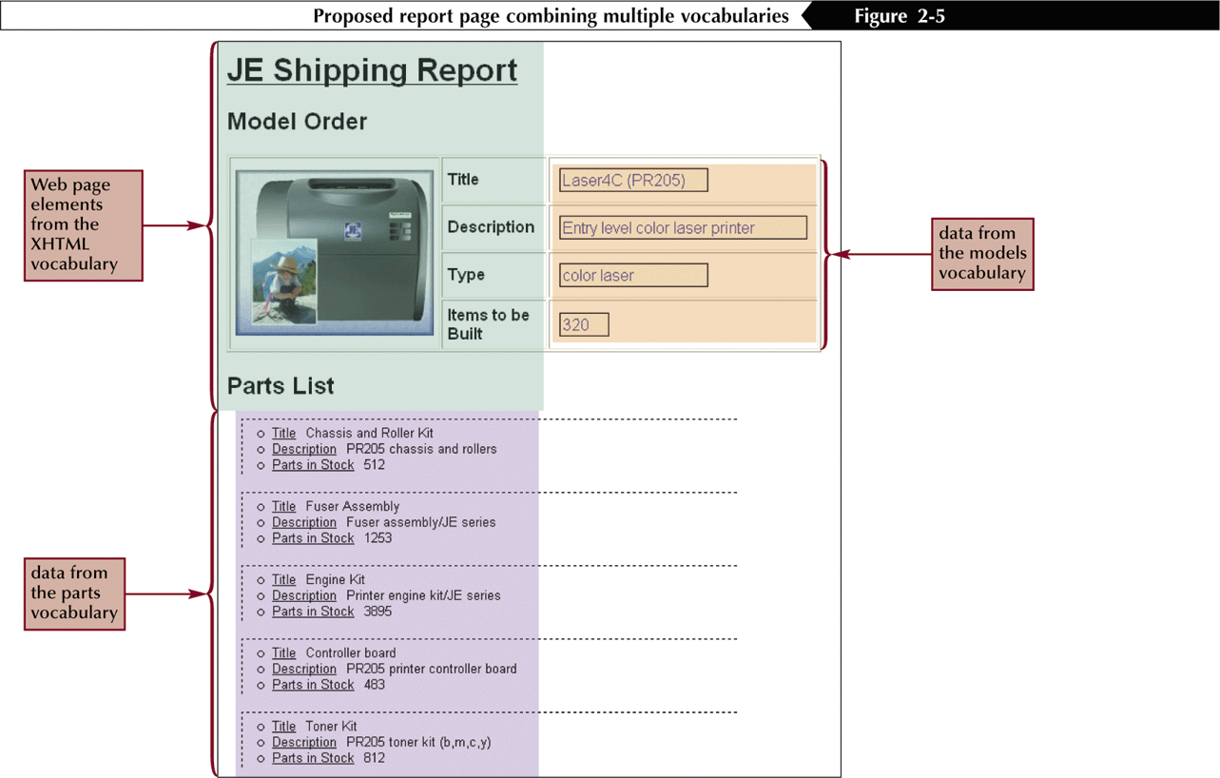
Combining XML Vocabularies
A document that combines several vocabularies is known as a compound document
Notes:
This is the kind of report that is common. When we ship this product we need to ship a bunch of things…

Slide 3
Working With Namespaces
Name collision occurs when elements from two or more documents share the same name.
Name collision is a problem only when concerned with validation. The document content only needs to be well-formed.
However, name collision will keep a document from being validated.
Notes:
Show before model and parts

Slide 4
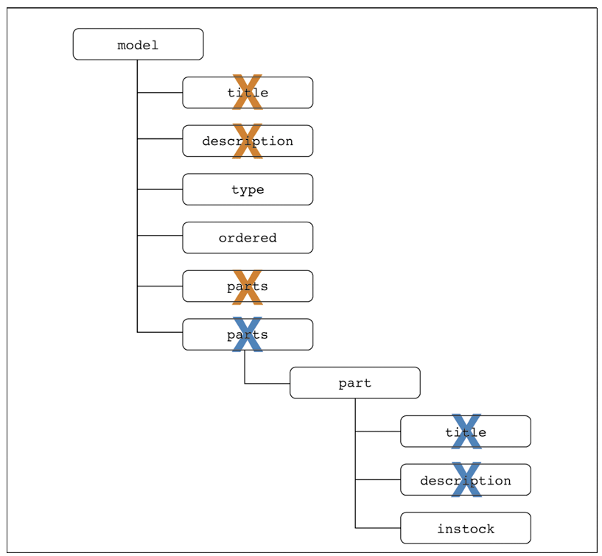
Name Collision Example

Slide 5
Declaring a Namespace
A namespace is a defined collection of element and attribute names.
Names that belong to the same namespace must be unique. Elements can share the same name if they reside in different namespaces.
Namespaces must be declared before they can be used.

Slide 6
Declaring a Namespace
A namespace can be declared in the prolog or as an element attribute. The syntax for an attribute used to declare a namespace in the prolog is:
xmlns:prefix=“URI”
Where URI is a Uniform Resource Identifier that assigns a unique name to the namespace, and prefix is a string of letters that associates each element or attribute in the document with the declared namespace.
Notes:
If no prefix is provided, xmlns defines the {default namespace}
i.e.

Slide 7
Declaring a Namespace
For example,
<model xmlns:mod=“http://jacksonelect.com/models”>
Declares a namespace with the prefix “mod” and the URI http://jacksonelect.com/models
The URI is not a Web address. A URI identifies a physical or an abstract resource.

Slide 8
Namespace scope
<?xml version="1.0"?>
<Book xmlns="http://www.library.com">
<Title>Sherlock Holmes - I</Title>
<Author>Arthur Conan Doyle</Author>
<purchase xmlns="http://www.otherlibrary.com">
<Title>Sherlock Holmes - II</Title>
<Author>Arthur Conan Doyle</Author>
</purchase>
<Title>Sherlock Holmes - III</Title>
<Author>Arthur Conan Doyle</Author>
</Book
Notes:
Class activity: identify the namespace for each of the elements above
elements Book, and Title, and Author of Sherlock Holmes - III and Sherlock Holmes - I are associated with the namespace http://www.library.com
elements purchase, Title, and Author of Sherlock Holmes - II are associated with the namespace http://www.otherlibrary.com

Slide 9
URIs, URLs, AND URNs
A physical resource is a resource one can access and work with such as a file, a Web page, or an e-mail address. A URL is one type of URI.
An abstract resource is one that doesn’t have any physical existence, the URI is used as an identifier or an ID.
Notes:
URL is a special type of URI which specifies a namespace (web location) or a web site

Slide 10
URIs, URLs, AND URNs
A proposed type of URI is the URN or Universal Resource Name. A URN is a persistent resource identifier, meaning the user need only know the name of a resource. An agency would then retrieve a copy of the resource independent of its location.
URNs take the form:
urn:NID:NSS
Notes:
NID is Namespace Identifier and NSS is a text string in that space
e.g. urn:isbn:0-619-01969-7
URL is a unique name to a specific location
URN is a unique name to a specific item
Can be used in web services to retrieve data from other sites, like the isbn for a book from Amazon

Slide 11
Applying a Namespace to an Element
Once it has been declared and its URI specified, the namespace is applied to elements and attributes by inserting the namespace prefix before each element name that belongs to the namespace.
<prefix:element>
content
</prefix:element>
Here, prefix is the namespace prefix and element is the local part of the element name.

Slide 12
Applying a Namespace to an Element
Prefixed names are called qualified names and an element name without a namespace prefix is called an unqualified name.
Qualified names can be added to a document using code entered directly into the document.
However, the more common way is to add the xmlns attribute to an element.

Slide 13
Declaring a Namespace as an Element Attribute
The syntax is:
xmlns:prefix=“URI”
Where prefix and URI are the prefix and URI for the namespace
Default namespaces do NOT apply to attributes (it must be explicit)

Slide 14
Declaring a Namespace as an Element Attribute
<mod:model xmlns:mod="http://jacksonelect.com/models">
<mod:title>Laser4C (PR205)</mod:title>
<mod:description>Entry level color laser printer</mod:description>
<mod:type>color laser</mod:type>
<mod:ordered>320</mod:ordered>
<mod:parts list="chx201,fa100-5,eng005-2,cbx-450V4,tn01-53" />
</mod:model>
Notes:
URI looks like a website, but that is not what it is for
Just needs to be unique
Does not even have to point to a real website, but usually points to a site for documentation
URI can be just a string like xmlns:mod=“JacksonElectricModels”
Since your site is unique with URL convention says to use that and a folder as your URI
Note the mod: on the root/parent element. This means it is also part of the namespace

Slide 15
Declaring a Namespace as an Element Attribute
…applies the namespace http://jacksonelect.com/models namespace to the model element and all of its child elements.
While the “mod” prefix was only added to the model element name, the XML parser considers the other elements parts of the model namespace and they inherit the namespace.

Slide 16
Declaring a Default Namespace
You can specify a default namespace by omitting the prefix in the namespace declaration.
The element containing the namespace attribute and all of its child elements are assumed to be part of the default namespace.

Slide 17
Default Namespace
<?xml version="1.0"?>
<Book xmlns="http://www.library.com">
<Title>Sherlock Holmes</Title>
<Author>Arthur Conan Doyle</Author>
</Book>
Notes:
In this case the elements Book, Title, and Author are associated with the Namespace http://www.library.com.

Slide 18
Default Namespace != no namespace
<?xml version="1.0"?>
<Book xmlns="http://www.library.com">
<Title>Sherlock Holmes</Title>
<Author>Arthur Conan Doyle</Author>
</Book>
<?xml version="1.0"?>
<Book>
<Title>Sherlock Holmes</Title>
<Author>Arthur Conan Doyle</Author>
</Book>
Notes:
In this case the elements Book, Title, and Author are associated with the Namespace http://www.library.com.
In the bottom example there is no namespace defined.

Slide 19
Using Namespaces with Attributes
Attributes can also be qualified by adding the namespace prefix to the attribute name. For example,
<element prefix:attribute="value">…</element>

Slide 20
Using Namespaces with Attributes
No element may contain two attributes with the same name.
No element may contain two qualified attribute names with the same local part, pointing to identical namespaces, even if the prefixes are different.

Slide 21
Using Namespaces with Attributes
<mod:model xmlns:mod="http://jacksonelect.com/models" mod:id="pr205">
<mod:title>Laser4C (PR205)</mod:title>
<mod:description>Entry level color laser printer</mod:description>
<mod:type>color laser</mod:type>
</mod:model>

Slide 22
Style Sheets and Namespaces
To declare a namespace in a style sheet, you add the following rule to the style sheet file
@namespace prefix url(uri);
Where prefix is the namespace prefix and uri is the URI of the namespace
Example:
@namespace mod url(http://jacksonelect.com/models)

Slide 23
Applying a Namespace to a Selector
Once a namespace is declared in a style sheet, associate selectors with that namespace using the syntax:
prefix|selector {attribute1:value1;
attribute2:value2;…}
For example:
mod|title {width: 50%;}
You also can use the wildcard symbol (*) to apply a style to any element within a namespace or to elements across different namespaces
Notes:
Older browsers may not support the use of the @namespace rule
Some use the backslash escape character before the namespace prefix in CSS style sheets:
prefix\:selector {attribute1:value1;
attribute2:value2;…}

Slide 24
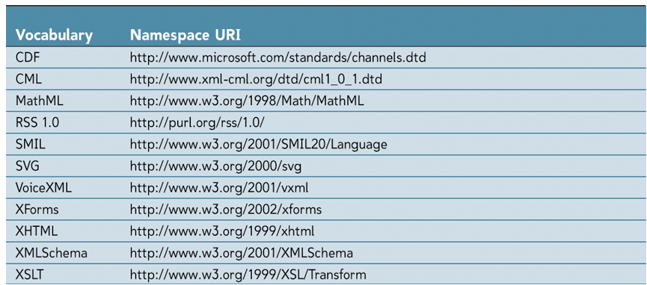
Standard Vocabularies
Standard vocabularies may be combined within single documents

Slide 25
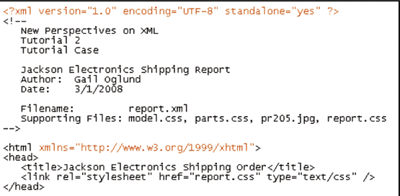
Converting HTML to XHTML
Notes:
For HTML Insert the following xml declaration as the very first line in the file (above the comment section):
<?xml version="1.0" encoding="UTF-8" standalone="yes" ?>
Add the following attribute to the opening <html> tag:
xmlns="http://www.w3.org/1999/xhtml“
Show after with order.xml and how it works.
Go through both css files and how they work with the namespaces
Show report.htm and how it worked

Slide 26
Summary
The scope of a declared namespace begins at the element where it is declared and applies to all the elements within the content of that element, unless overridden by another namespace declaration with the same prefix name.
Both prefixed and {default namespace} can be overridden.
Both prefixed and {default namespace} can be undeclared.
{default namespace} does not apply to attributes directly.
A {default namespace} exists only when you have declared it explicitly. It is incorrect to use the term {default namespace} when you have not declared it.
No namespace exists when there is no default namespace in scope.

